Slide 1
Elements
스프링보드 원격학원

Slide 2
Matter
Matter refers to any substance that occupies space and has mass.
*mass
*volume
Matter can be classified into two categories: pure substance and mixtures.

Slide 3
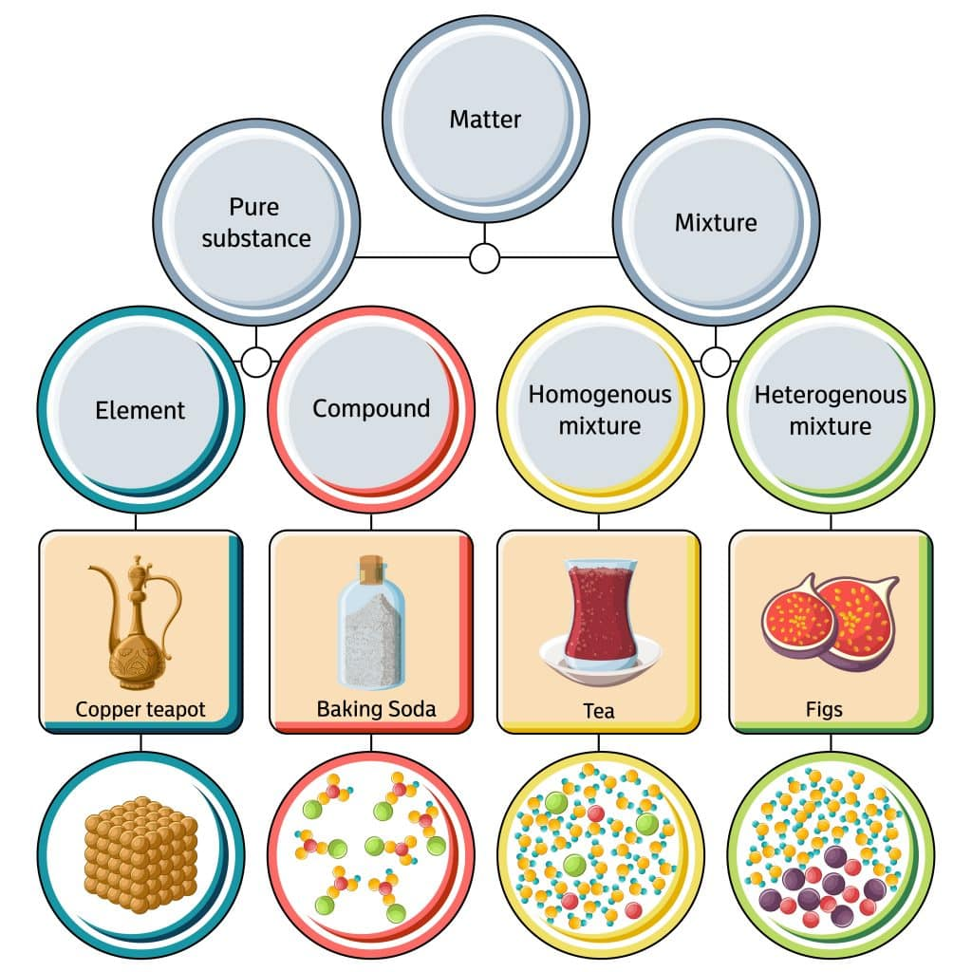
Classifying matter
element
compound
homogeneous mixture
heterogeneous mixture
source: https://ngsmagnified.com/textbooks/matter/section-1-composition-of-matter/

Slide 4
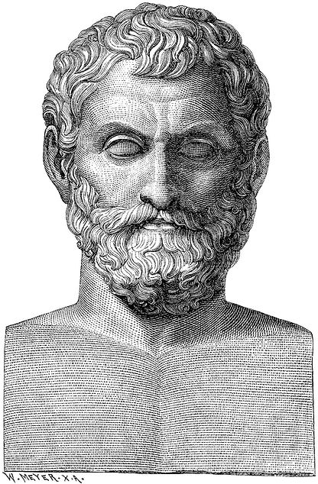
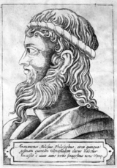
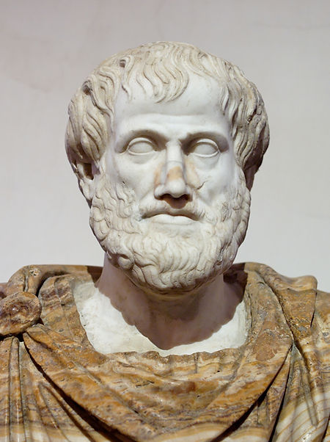
Elements
An element refers to a substance that cannot be broken down further into simpler components by any chemical means.
Ancient Greek philosophers’ various perspectives on elements
Θαλής, Thales
Ἀναξιμένης, Anaximenes
Αριστοτέλης, Aristotle

Slide 5
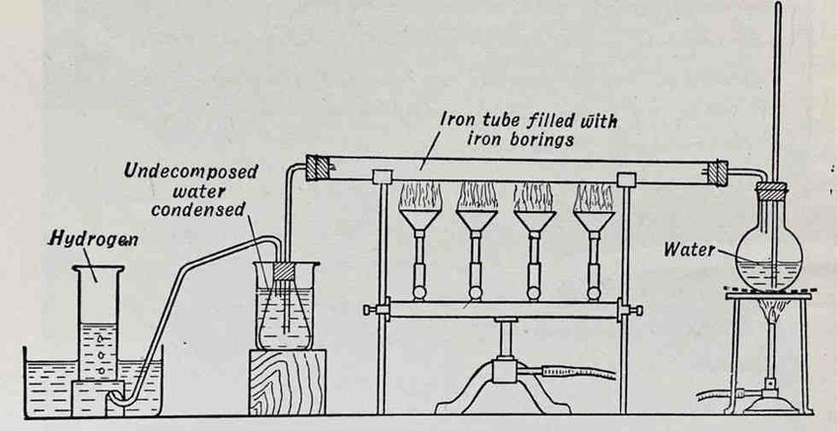
The discovery of the composition of water
Antoine-laurent de Lavoisire 🇫🇷
source: Szydło (2021) Hydrogen – Some historical highlights

Slide 6
Elements
An element is the smallest unit of matter.
There have been 118 elements found so far.
94 elements are naturally occuring.
Each element has different chemical properties.
*chemical properties

Slide 7
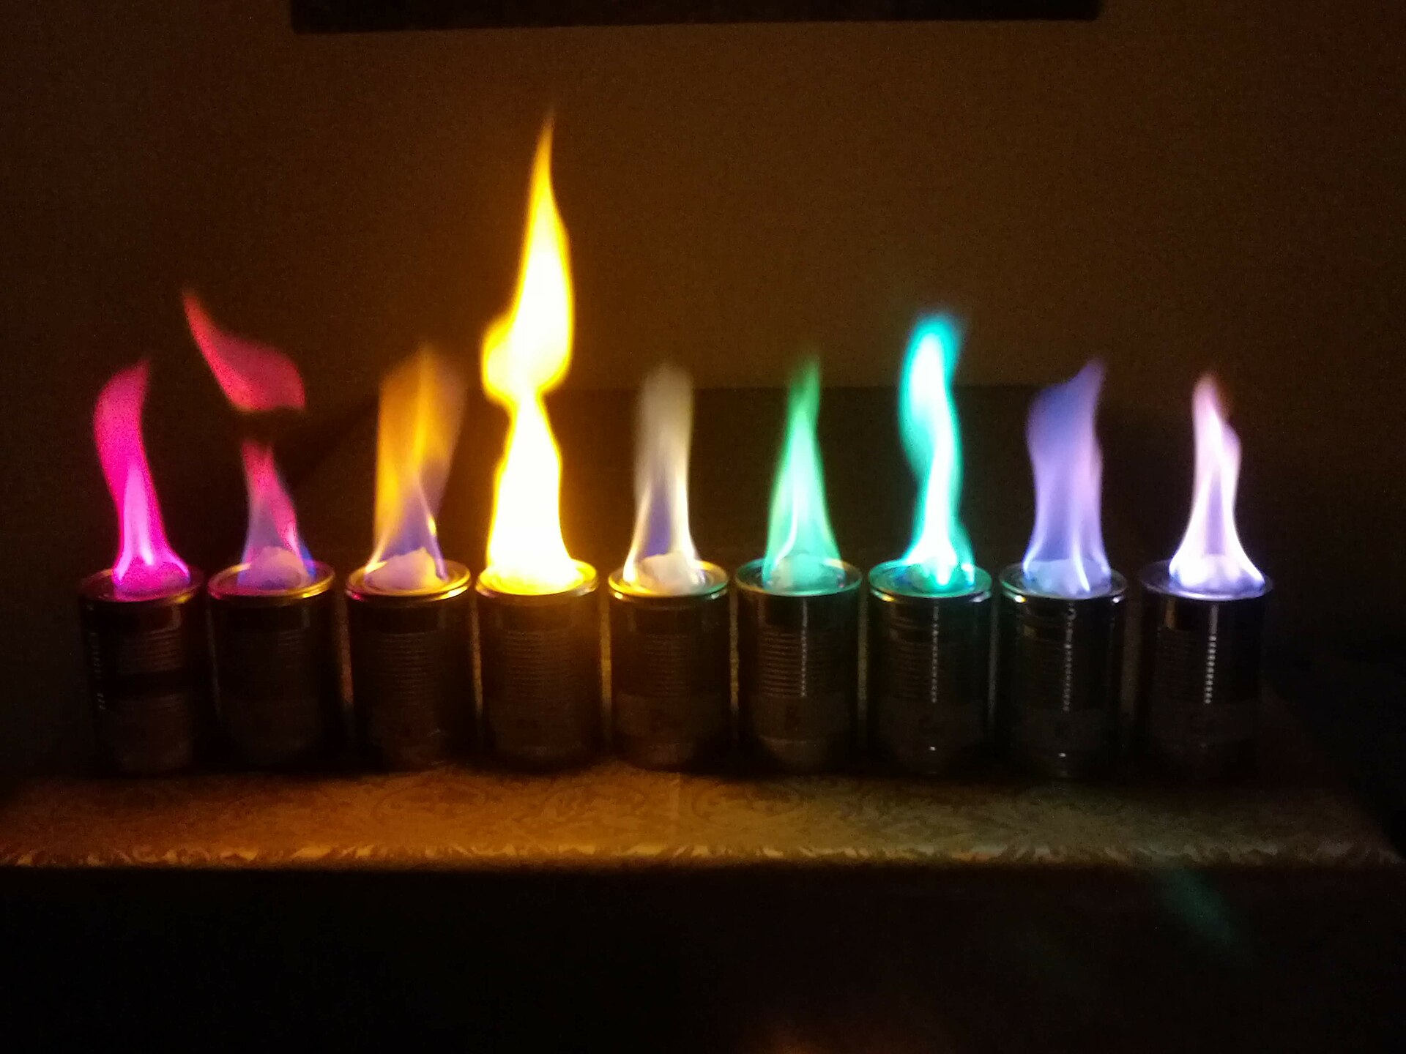
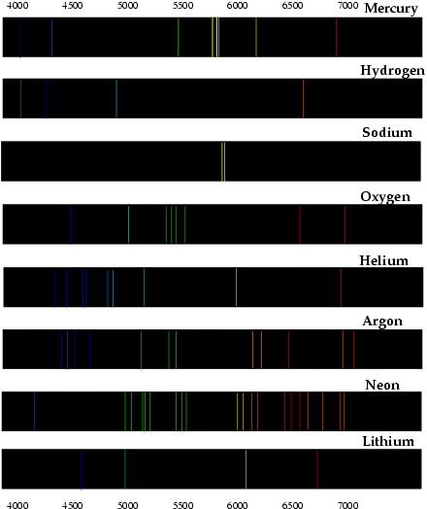
Flame test and spectral lines of elements

Slide 8
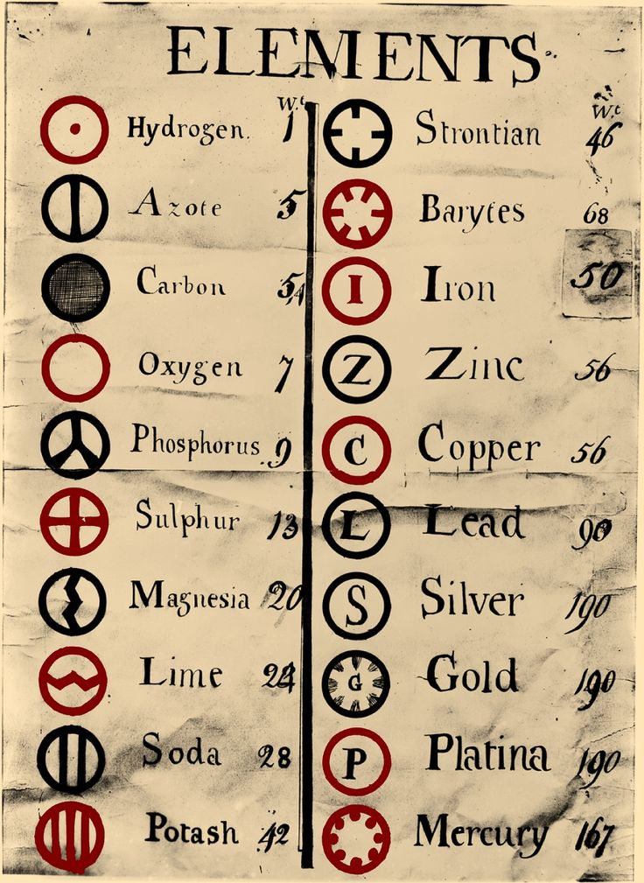
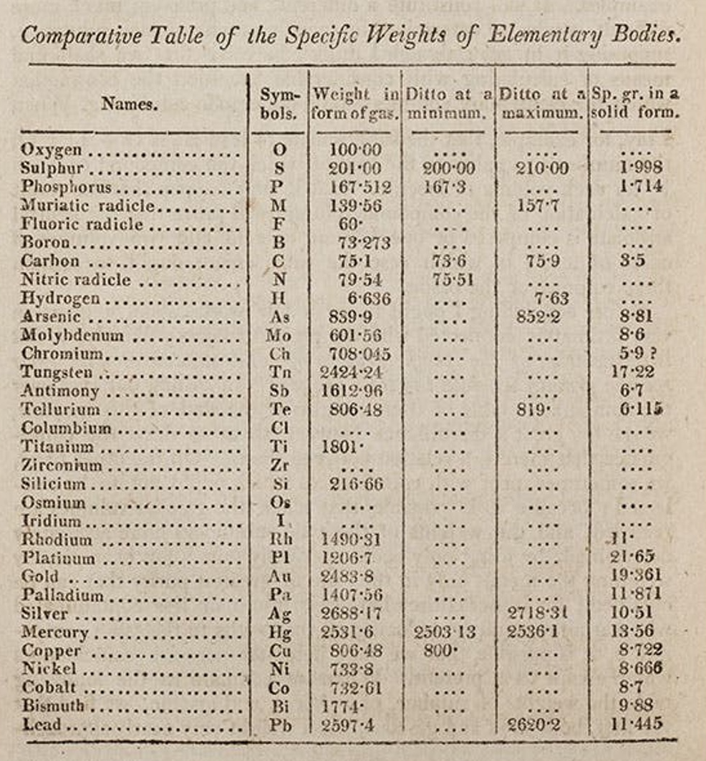
Chemical symbols
Jöns Jacob Berzelius 🇸🇪

